Slide 1
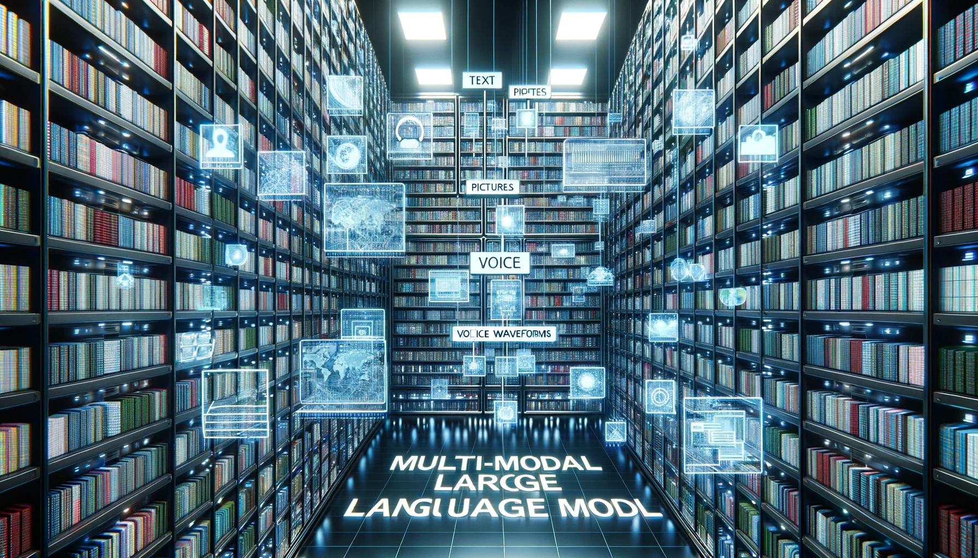
Photo of a vast digital data archive with rows upon rows of virtual storage. Clearly marked sections host text files, pictures, voice waveforms, and video frames. Hovering grandly and in a color that stands out against the backdrop is the phrase 'Multi-Modal Large Language Model', underscoring the essence of multidimensional data fusion.

Slide 2
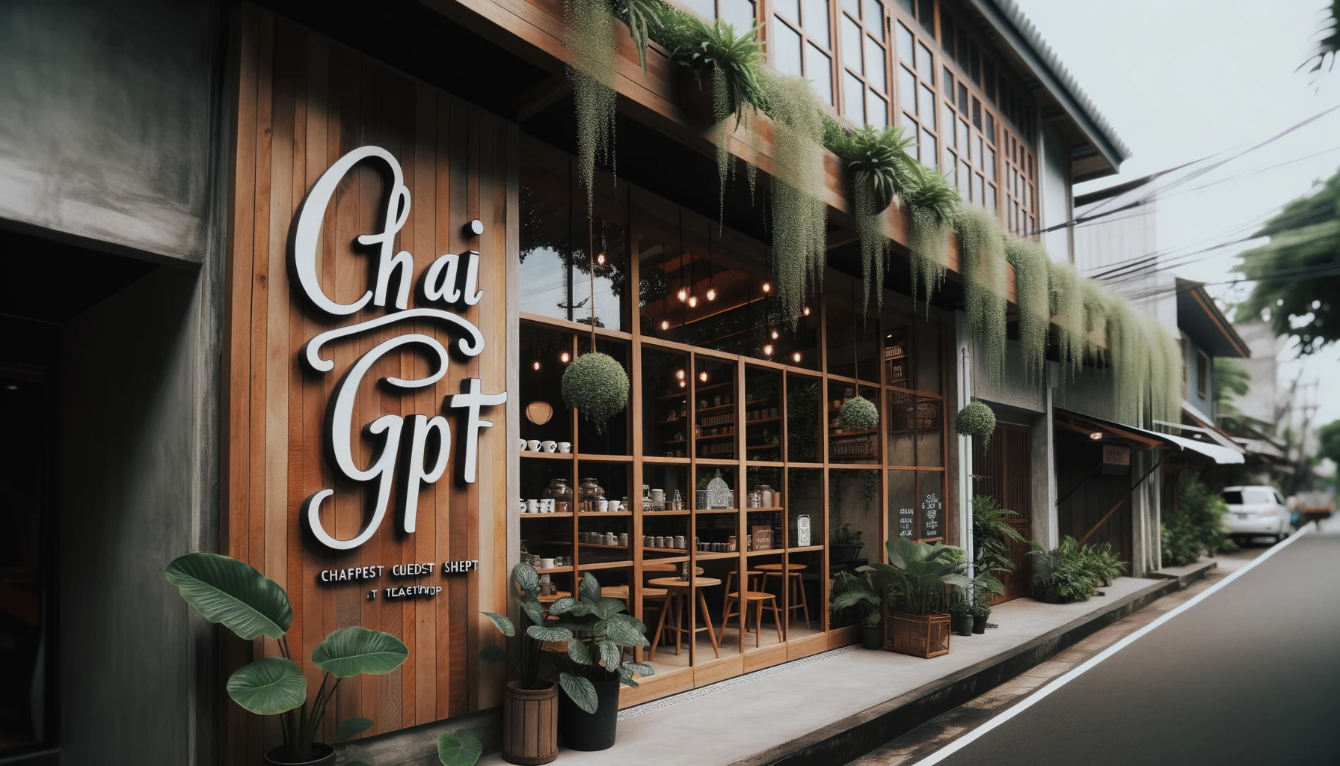
Photo of a cozy, modern tea shop with wooden exteriors and large windows. Plants hang outside, adding a touch of greenery. The prominent nameboard reads 'Chai GPT' in elegant, cursive script against a rustic backdrop.

Slide 3
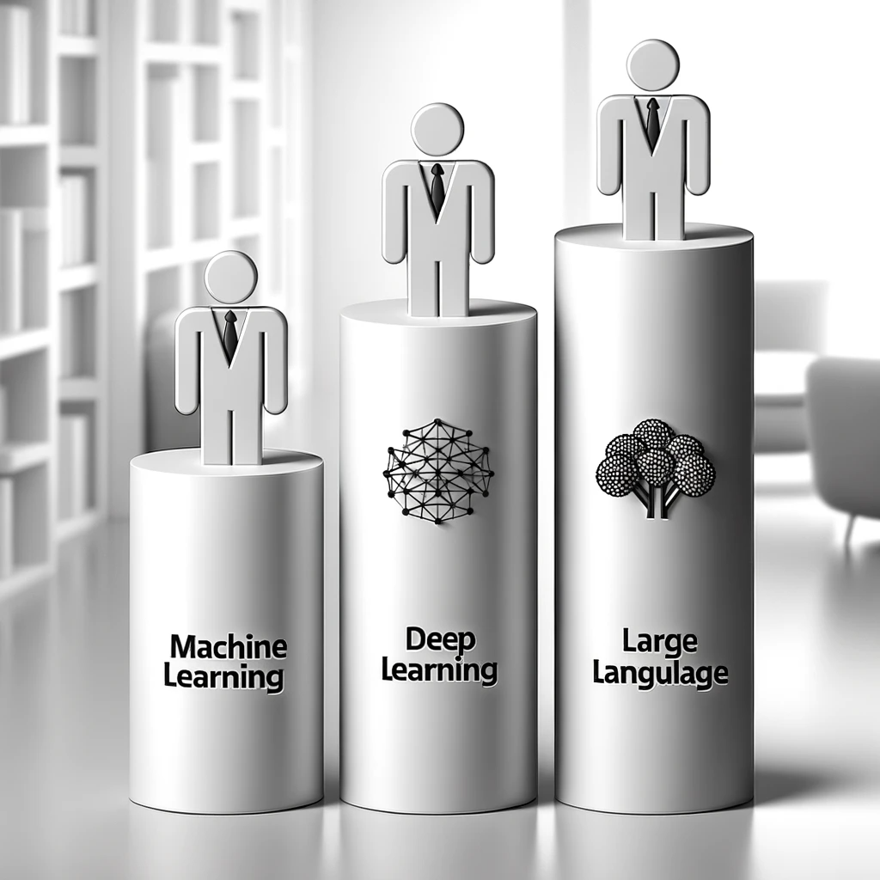

Slide 4
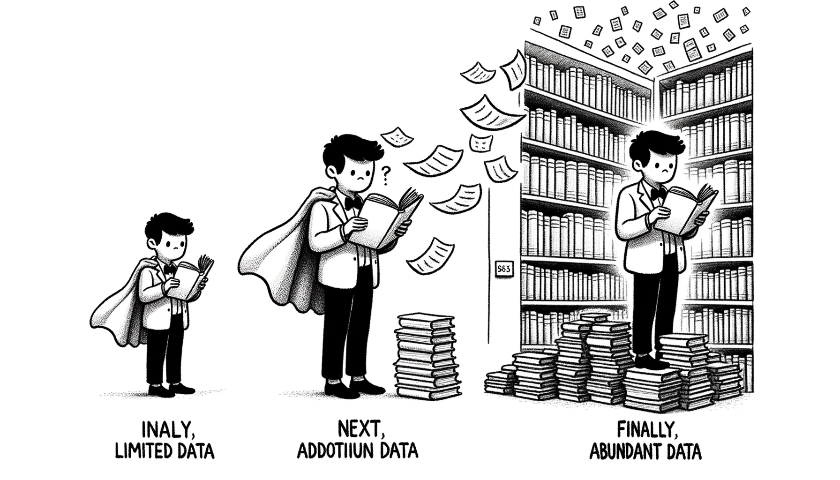
Drawing of a scholar's journey: initially, they hold a single paper looking uncertain, signifying limited data. Next, they're reading a hefty book, representing additional data. Finally, they're in a large library, scanning multiple books confidently, symbolizing abundant data.

Slide 5
Text to Image

Slide 6
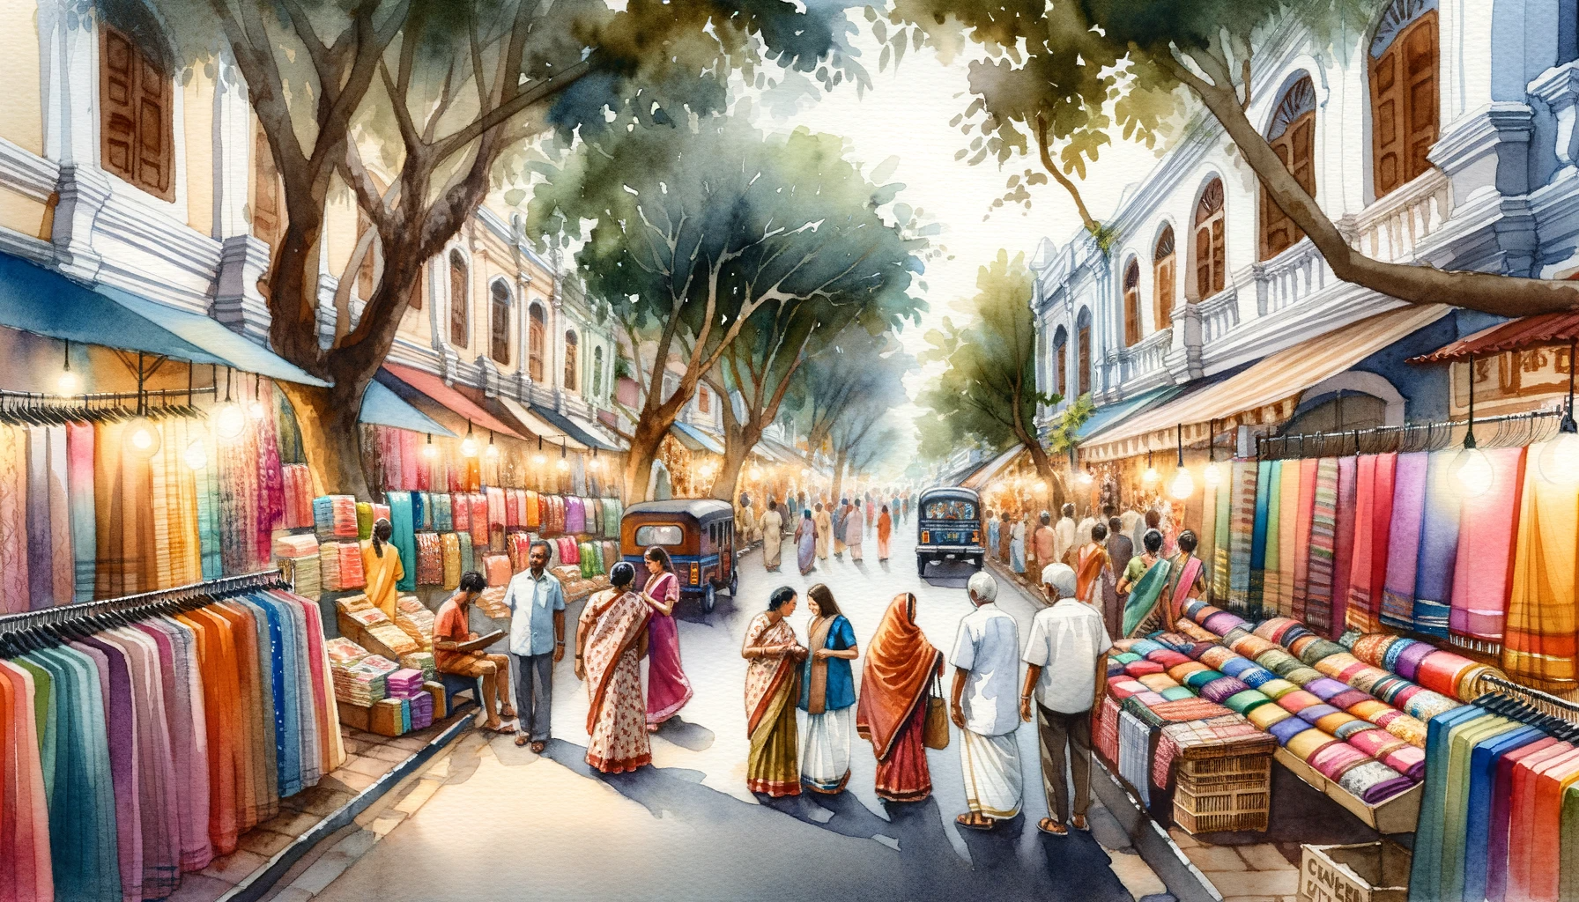
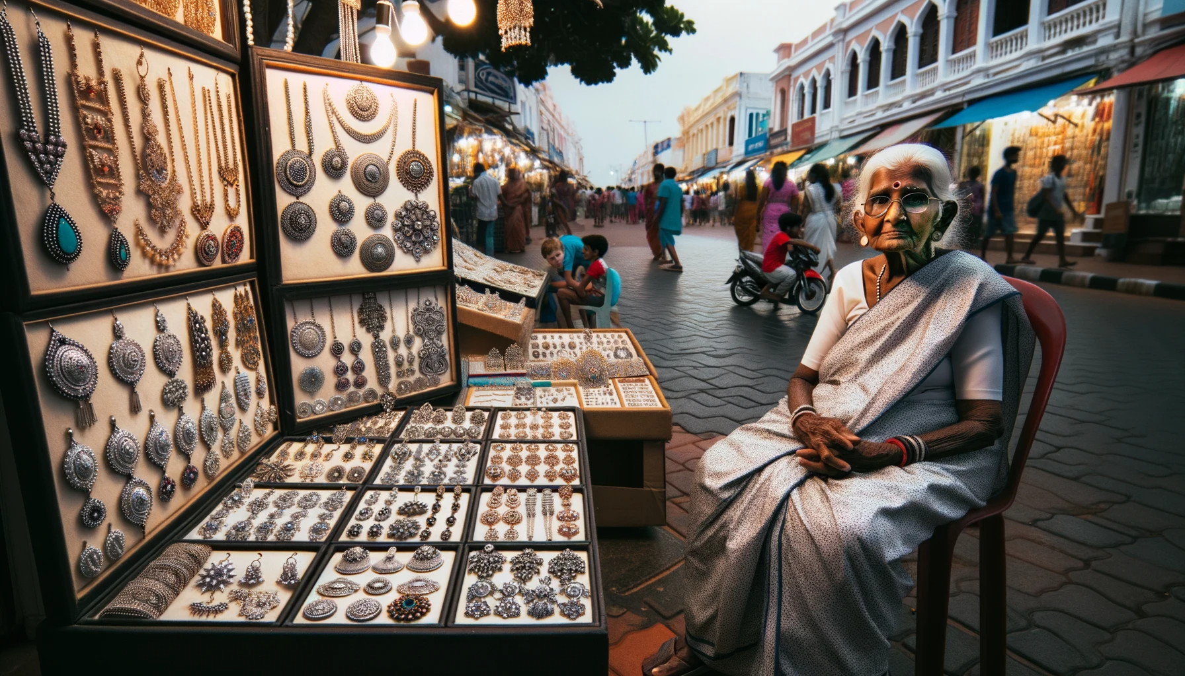
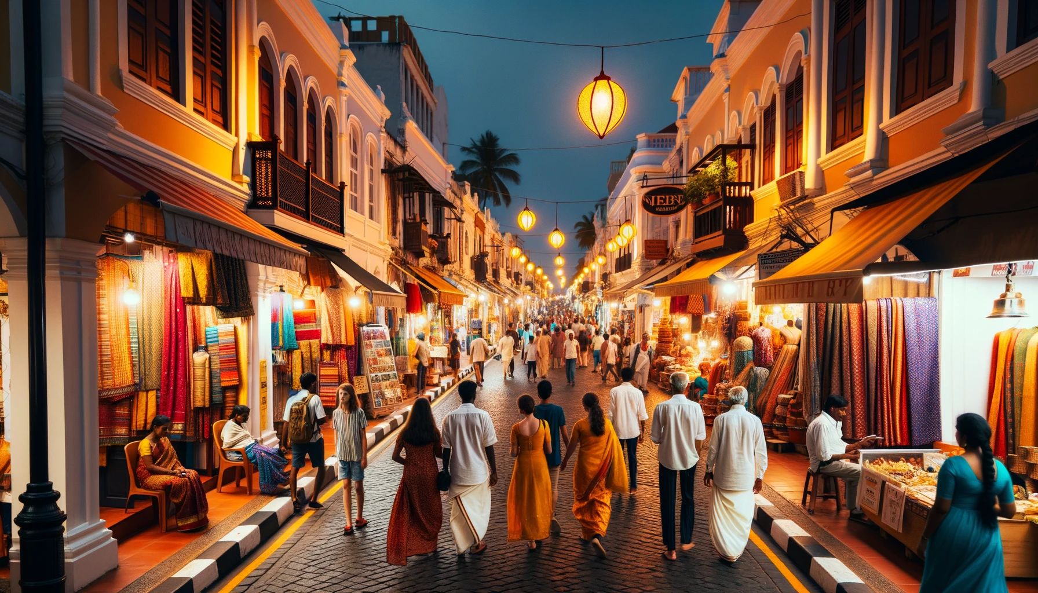

Slide 9
Image to Text

Slide 10
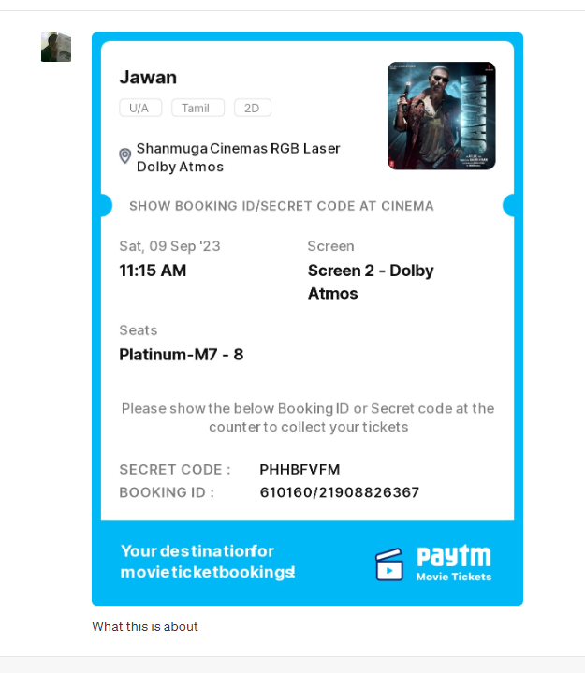


Slide 11
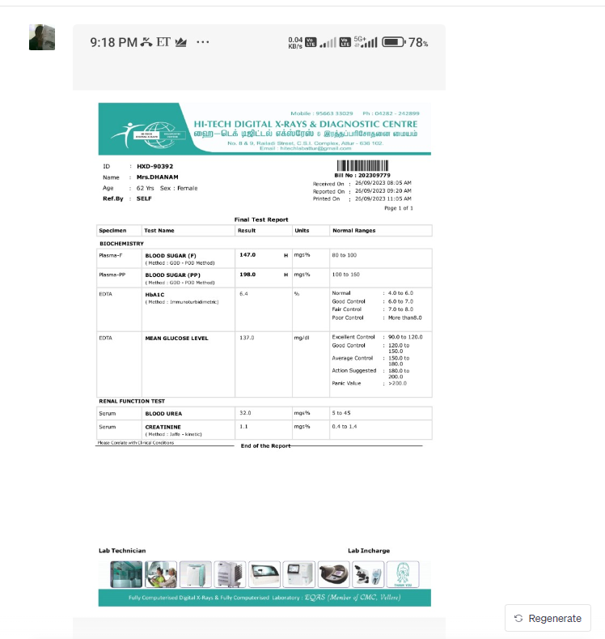
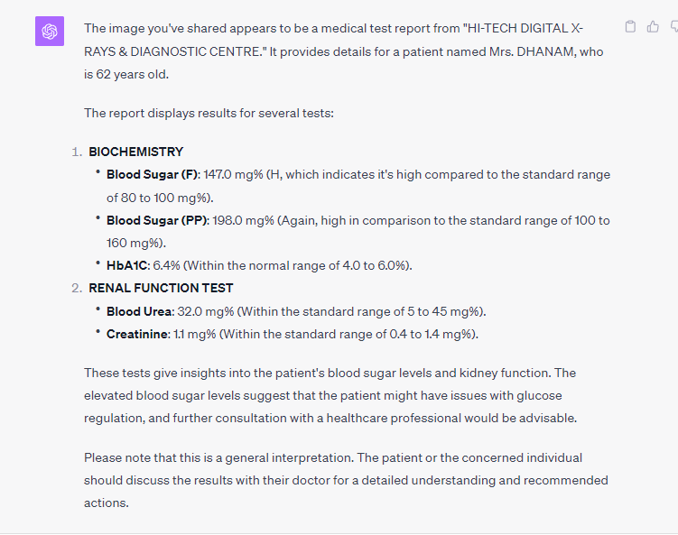

Slide 12
Voice
https://www.linkedin.com/posts/senthilnayagam_voicecloning-generatieveai-activity-7094985293396668416-4Fr2?utm_source=share&utm_medium=member_desktop

Slide 13
Video
https://www.linkedin.com/embed/feed/update/urn:li:ugcPost:7084048413922643968

